Slide 1

Image Caption Generation USING CLIP

Slide 2

ABSTRACT
This paper presents a novel approach to image caption generation harnessing the power of OpenAI's CLIP (Contrastive Language-Image Pretraining) model. CLIP, a state-of-the-art multimodal model, enables the understanding of images and text in a unified semantic space. By leveraging CLIP's robust representations of both images and corresponding text, we propose an image caption generator that seamlessly combines visual and textual cues for accurate and contextually relevant captioning. Our method utilizes CLIP's pre-trained vision and language encoders to encode images and generate captions using a decoding strategy that encourages coherence and diversity. Through extensive experimentation and evaluation on diverse image datasets, we demonstrate the effectiveness and versatility of our approach in producing descriptive and informative captions across various domains. Moreover, we explore the integration of fine-tuning techniques to adapt CLIP to specific captioning tasks, further enhancing its performance and adaptability. We envision our CLIP-based image caption generator as a powerful tool with applications in content generation, visual storytelling, and accessibility, ultimately bridging the gap between visual and textual modalities in the digital realm.

Slide 3
Literature survey
From Show to Tell: A Survey on Deep Learning-based Image Captioning (2021): This survey provides a comprehensive overview of deep learning-based image captioning models, covering architecture, techniques, evaluation metrics, and recent advancements. It delves deeper than other surveys and analyzes a large number of papers. (arXiv: [https://arxiv.org/pdf/2107.06912])
A Systematic Literature Review on Using the Encoder-Decoder Models for Image Captioning in English and Arabic Languages (2023): This survey focuses on encoder-decoder models for image captioning, comparing techniques and implementation specifics across different languages (English and Arabic). It also discusses recent developments like Conditional GAN-based models and meta-learning approaches. (MDPI: [https://www.mdpi.com/2076-3417/13/19/10894])

Slide 4
Literature survey
Image Captioning using Deep Learning: A Systematic Literature Review (2019): This survey mainly focuses on the period 2017-2019, analyzing the application of various deep learning methods like CNNs, LSTMs, and attention mechanisms in image captioning. It explores commonly used datasets and evaluation metrics.
A Systematic Literature Review on Image Captioning (2020): This survey provides a brief overview of advancements in image captioning within the last four years, highlighting key techniques, challenges, and promising directions. It emphasizes the recent surge in research and the need for more comprehensive comparisons of results. (MDPI: [https://www.mdpi.com/2076-3417/9/10/2044])
Survey on Neural Network based Image Captioning Techniques (2018): This survey offers a good starting point for understanding early developments in image captioning with neural networks, covering various architectures and learning approaches.

Slide 5
Literature survey
A Review of Deep Learning Techniques for Image Captioning (2020): This review dives into the technicalities of deep learning models used for image captioning, explaining architectures like CNNs, LSTMs, and their specific functionalities within the context of caption generation.

Slide 6
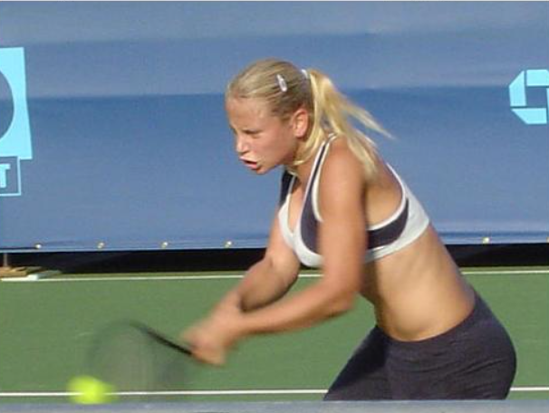
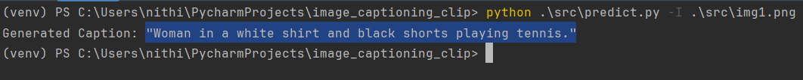
OUTPUT

Slide 7
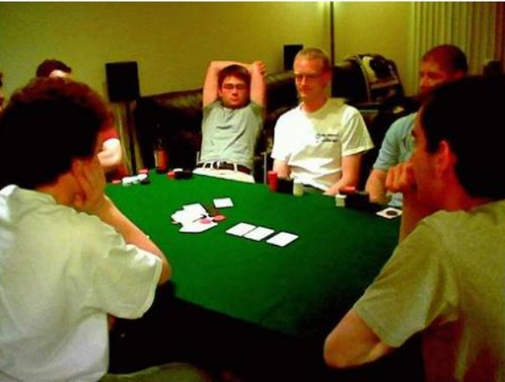
OUTPUT

Slide 8
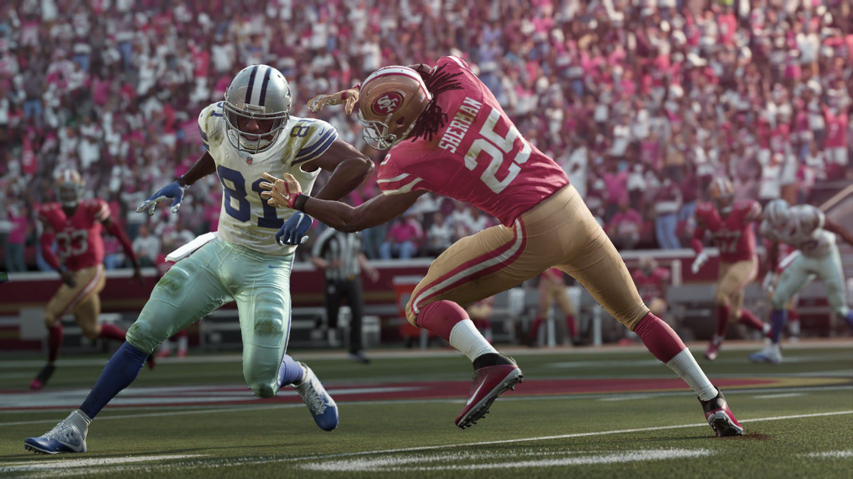
OUTPUT

Slide 9

OUTPUT

Slide 10
THANK YOU

